Slide 1
G-SUITE METRICS CSC 505/605 Fall 2019
By: Advisor :
Lavanya Goluguri Dr. Sowmya Mohanty
Anusha Vanama Mentor:
Jackie Cuong Nick Young Henry Reichard
Hieu Vo

Slide 2

PROJECT OVERVIEW
G Suite is a set of cloud computing, productivity and collaboration tools, software and products developed by Google.
G-suite services include Google Accounts, Google Calendar, Google Hangouts, Gmail, Google+, google drive/docs, Chrome OS devices, Google sites, Mobile devices google applications etc.
We are mainly focusing on the metrics Drive, Meet, Gmail, Accounts and Calender.

Slide 3
TASK BY MEMBER
GOOGLE DRIVE:
My main task for this project is to work on the drive data, find its anomalies, patterns, distributions and predictions.
In the work of progress towards the goal, I have done the data cleaning and the statistical analysis, Distributions, Point estimates, Hypothesis testing on the prime parameters of the drive data.

Slide 4
BASIC DATA EXPLORATION
DATA DESCRIPTION
Google drive data is originally 102427 rows x 3 columns.
The 3 columns are Time, Metric name and Value, and it has many Nan Values, which I replaced with the mean.
I reshaped the data set with unique Metrics as columns, now the data set is around 831 rows x 143 columns.
Now the drive data has main metrics that are related to active users, forms, documents, presentations, spreadsheets, drawings and others.

Slide 5
MAIN PARAMETERS IN THE DRIVE DATA
1day_active_users 30day_active_users
Google_forms_created Google_forms_edited
Google_documents_created Google_documents_edited
Google_presentations_created Google_presentations_edited
Google_Spreadsheets_created Google_spreadsheets_edited
Google_drawings_created Google_drawings_edited

Slide 6
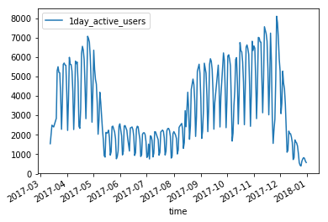
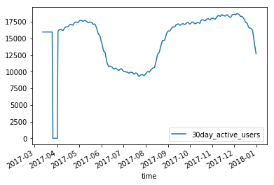
COMPARISIONS BETWEEN 1DAY AND 30DAY ACTIVE USERS
2017- 2018 1day_active_users and 30day_active_users data spread

Slide 7
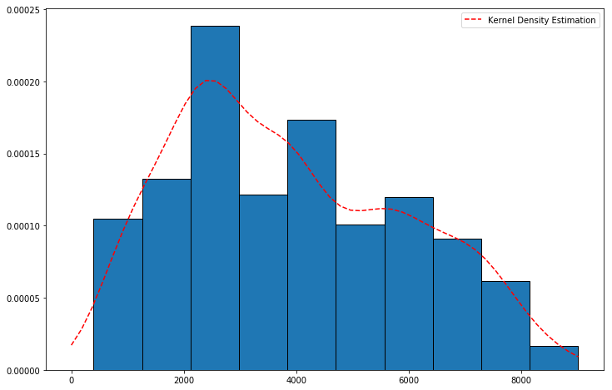
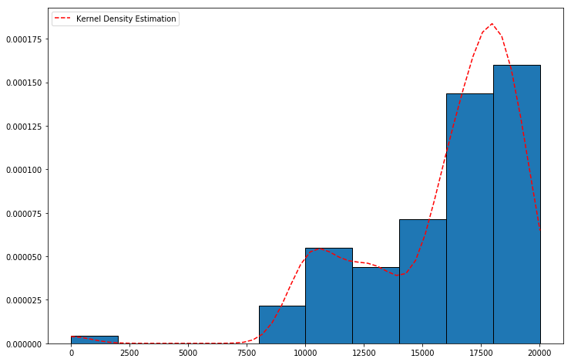
DISTRIBUTIONS
1day_active_users and 30day_active_users data distributions

Slide 8
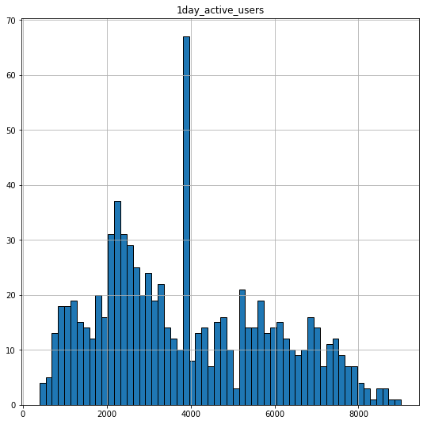
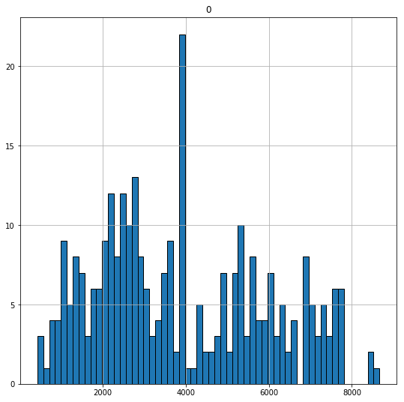
POINT ESTIMATES
1day_active_users and Sample data from 1day_active_users data distributions

Slide 9
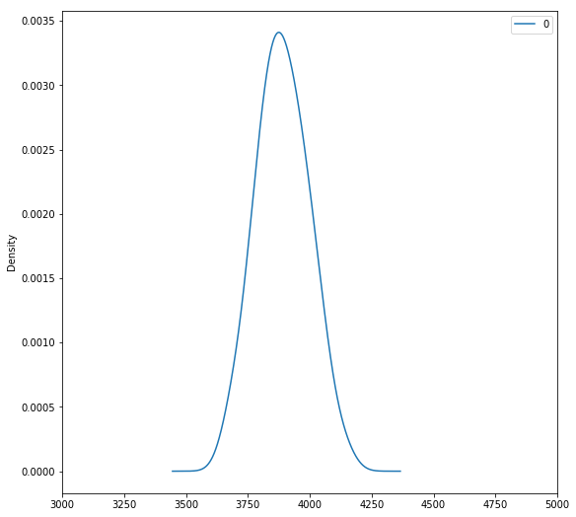
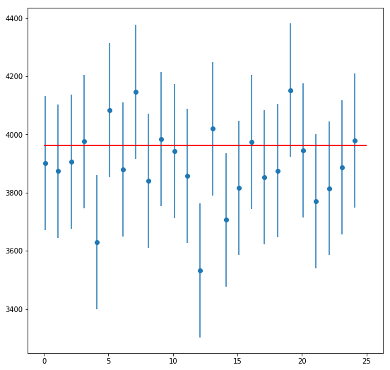
CENTRAL LIMIT THEOREM AND CONFIDENCE INTERVALS
Took more samples and plotted their means to see if this mean is closer to true mean, it is off by 10.3
Calculated a bunch of confidence intervals by calculating both Z-critical value and t-critical values
to capture the true mean.

Slide 10
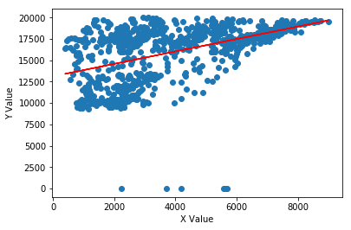
CORRELATION
The 1day_active_users and 30day_active_users have a correlation of 0.45.
There is only a slight correlation between the two, It is not like every time there is a growth in 1day active users, there is growth in 30day active users.

Slide 11
HYPOTHESIS TESTING AND RESULTS
ACTIVE USERS: 1 day active users is similar to 30 day active users. P value is 0.17, Yes they are similar!
FORMS: 2018 spring semester data is similar to 2019 spring semester data.
2018 spring semester data is similar to overall data, P value is 0.4 but it is different from the 2019 spring semester data, P value is 0.02.
DOCUMENTS: Documents created is similar to documents edited. P value is 0.2, Yes they are similar!

Slide 12
HYPOTHESIS TESTING AND RESULTS
SPREAD SHEETS: April Month spreadsheets and May month spreadsheets data is similar.
April data is similar to the overall data, P value is 0.11, May data is different from the overall data and the April data, p value is 0.001
PRESENTATIONS: 2017 presentations data is similar to 2018 presentations data.
2017 data is similar to the overall data , but 2018 data is different form the 2017 and overall data as well.

Slide 13
TASK BY MEMBER
GOOGLE MEET:
There are 55 unique metric names in Google meet. Our mentor suggested me to mainly focus on below 6 metrics under Google Meet. Our mentor is also interested in the comparison of the types of devices (iOS/ jamboard/android etc)
google.meet:total_call_minutes
google.meet:num_30day_active_users
google.meet:num_meetings
google.meet:num_calls
google.meet:average_meeting_minutes
google.meet:total_meeting_minutes

Slide 14
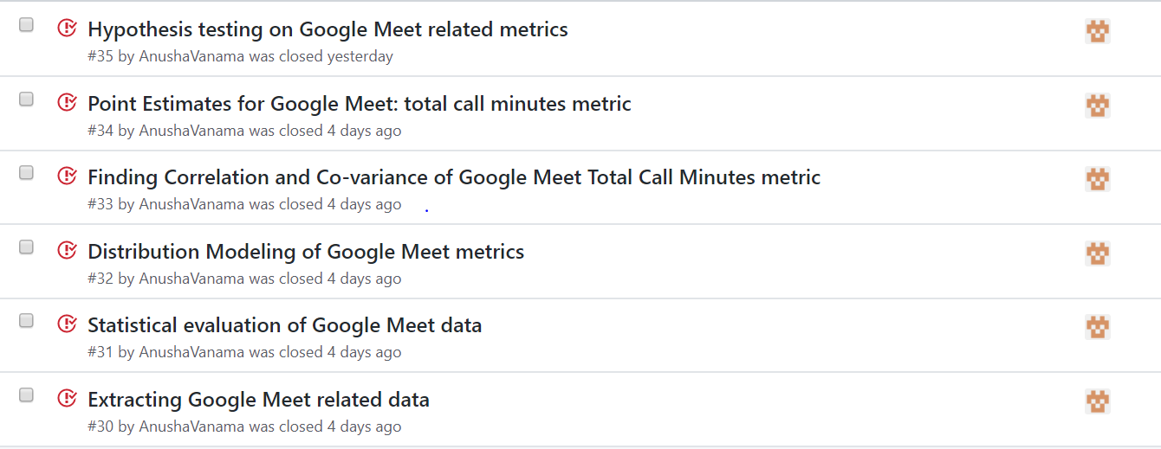
TASKS

Slide 15
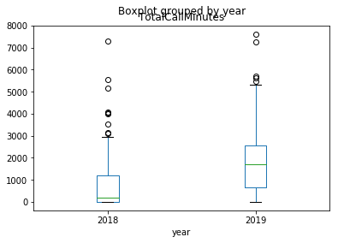
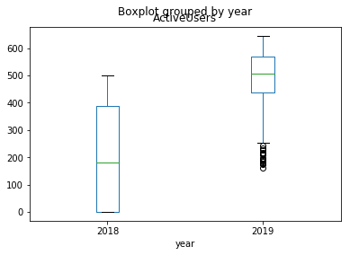
Statistical evaluation of data
There are 55 unique metric names, 29434 observations under Google Meet recorded from January 14th, 2018 to August 17th, 2019. Some of the Metric Values of Google Meet includes Number of users, Number of Minutes, Number of Meetings, Number of Calls, Usage of Chromebox and Usage of Chromebase.
Mean value is greater than median for total_call_minutes, num_calls, num_meetings, total_meeting_minutes. Maximum Outlier values are present for all these metrics.
Mean value is lower than median for num_30day_active_users, average_meeting_minutes. Minimum outlier values are present for these metrics.
Variance and Standard Deviation are not the right measures of spread as our data is having outlier values
Median absolute deviation is the right measure of spread for all the above metrics.

Slide 16
Statistical evaluation of data
Maximum number of total_call_minutes is 7623 minutes recorded on 2019-07-01.
Maximum number of calls are 159 calls recorded on 2019-03-21.
Maximum number of meetings are 39 meetings recorded on 2019-03-21.
Observed that there are more number of calls and meetings are scheduled during fall advising period which was started on March 18th 2019.
Maximum number of total_meeting_minutes is 1358 minutes recorded on 2018-12-11.
Maximum number of 30 day active users are 646 recorded in the month of April (2019-04-16).
Maximum number of Average meeting minutes is 174 minutes recorded on 2018-12-09.

Slide 17
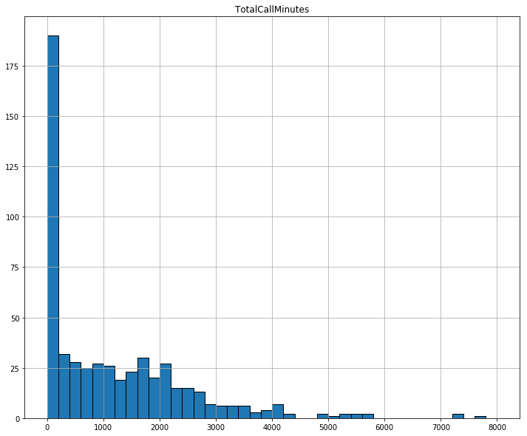
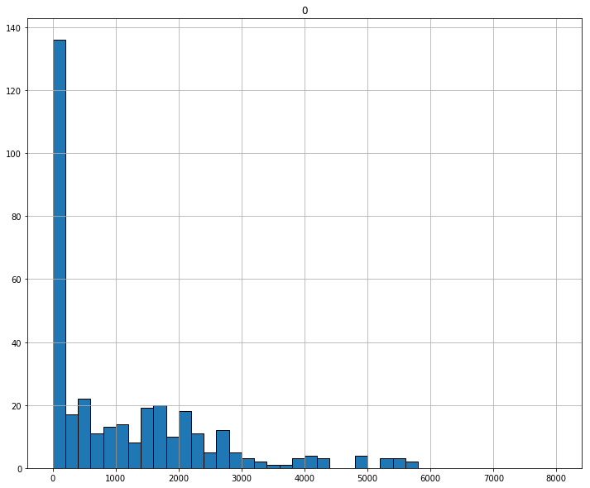
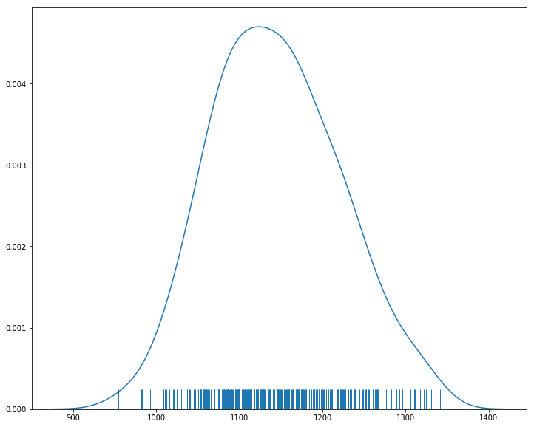
Point Estimates
Used Point estimates to estimate the mean of total call minutes for all days
Point estimate based on a sample of 400 observations overestimated the true call minutes mean by 22.560137 minutes and the distribution is not normal for sample data as well.
Created a sampling distribution by taking 300 samples from our call minutes data and then making 300 point estimates of the mean.
The sampling distribution appeared to be normal after applying Central Limit Theorem and the mean of the sampling distribution approached the true mean, there is only a difference of 3 minutes

Slide 18
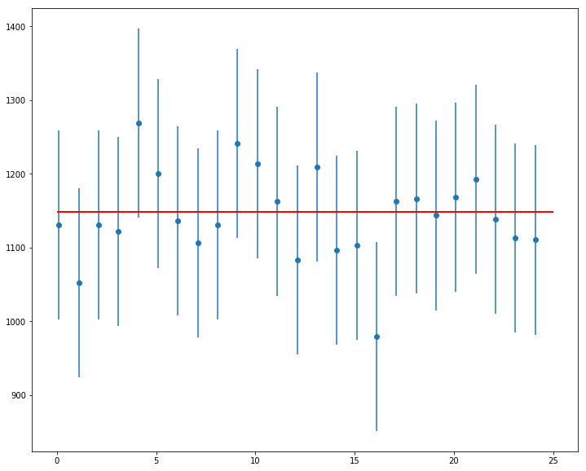
Confidence intervals
The confidence interval we calculated is very close the true call minutes mean of 1148.051565. 24 out of 25 Samples overlapped the red line marking the true mean in a 95% confidence interval.

Slide 19
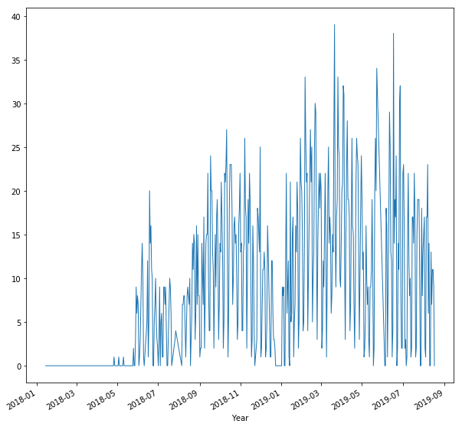
Distribution modeling
Observed that google meet application usage is very less in UNCG from Jan 2018 to June 2018. Metric values are 0 for most of the days. Eg: Number of meetings held using google meet is 0 for 159 days out of 543 days.

Slide 20
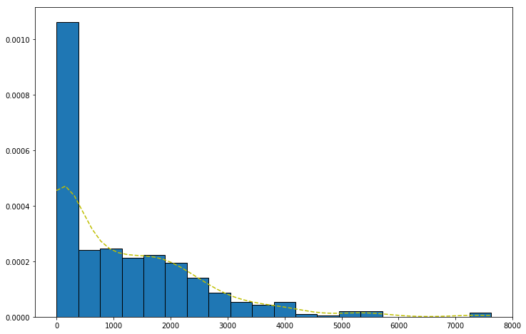
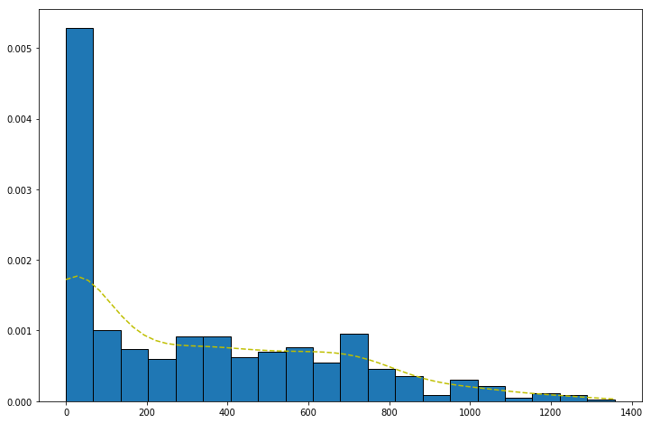
Distribution Modeling
Plotted Total Call Minutes data using Histograms to observe what sort of distribution will fit my data. It followed exponential distribution.
Kernel Density Estimator is used to find probability density function (PDF) for Total Call Minutes and Total meeting Minutes data.

Slide 21
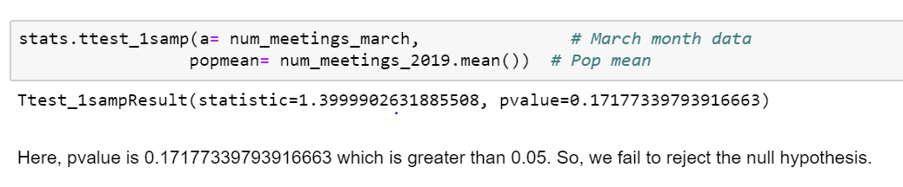
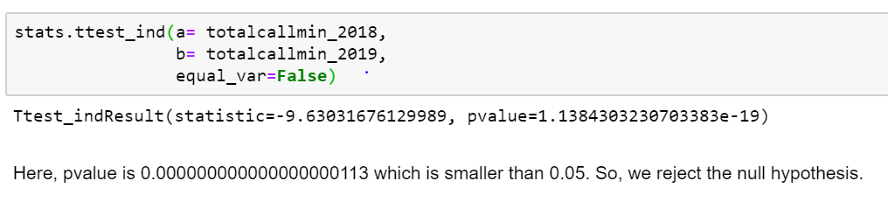
Hypothesis testing
Tested whether the mean of number of meetings for Google Meet in the month of March 2019 differs from the mean of Number of meetings for Google meet in Year 2019 using One-Sample t-test.
Tested whether the mean of total call minutes for Google Meet in the year 2019 differs from year 2018 using Two Sample t-test
Null Hypothesis is that both the means are similar and Alternate hypothesis is that they are different.

Slide 22
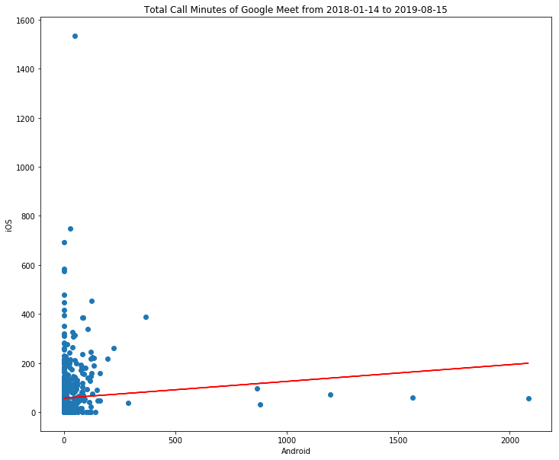
Correlation and Co-variance within the data.
Our mentor is interested in the comparison of the types of devices (ios/android etc). I tried finding Correlation between total_call_minutes_ios, total_call_minutes_android, total_call_minutes
Correlation of Android and iOS: 0.08, Correlation of Android and Total: 0.23, Correlation of iOS and Total: 0.51
The closer to 0 the correlation coefficient is, the weaker the relationship between the variables. Here, there is weaker relationship between Android and iOS usage of google meet.

Slide 23
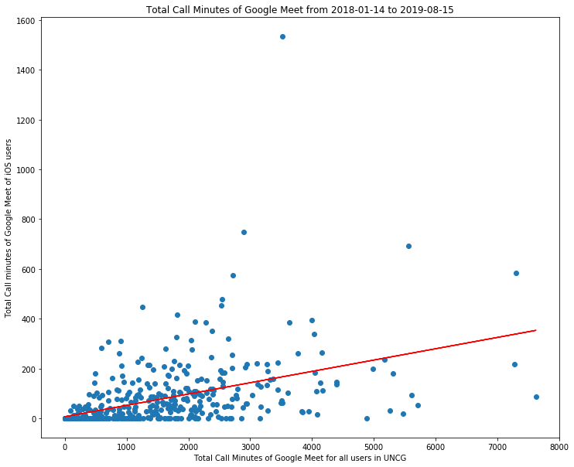
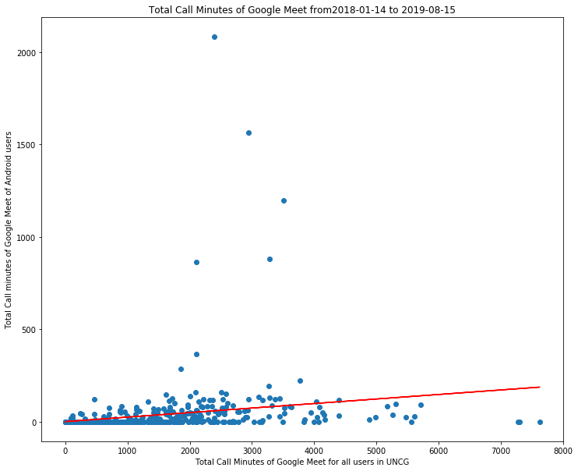
Correlation and Co-variance within the data.
There is better relationship between Total usage and iOS usage of google meet when compared to the relationship between Total Usage and Android Usage.

Slide 24
TASK BY MEMBER
GMAIL Analysis (Henry Reichard):
Performed data cleaning
Basic Statistics and point estimates
Distributions and building an estimator
Finding a correlation with the attributes
Hypothesis Testing
Outside research: kstests, there is no .fit functions for discrete distributions in scipy.stats ---> Lazy

Slide 25
BASIC DATA EXPLORATION
DATA DESCRIPTION
The data was collected from 03-23-2015 to 08-19-2019. I have separated the gmail related data from the original dataset, and created a new data frame and csv file. I moved all unique attributes from the rows to be there own columns.
The data frame has 28 columns and 1545 rows. Each row represents a new day from 3-23-2015 through 08-19-2019. I set the row column as index and passed it through pd.datetime. Now it is easy to plot and index the data.
The mentor has told me which attributes he wants me to prioritize on and those attributes are emails received, emails sent, inbound rejected emails, inbound spam emails, and inbound non spam emails.
DATA CLEANING
I cleaned the data by dropping nan value rows and 0 value rows that occurs when G-Suites are down. Luckily the number of dropped rows were marginal, around 40 rows, so it did not affect the data that much. The data is relatively clean so I didn't have to do further data cleaning.

Slide 26
STATISTICAL DATA EVALUATION
BASIC STATISTICS
Mean: emails received =280777, emails sent = 27640, inbound rejected emails = 16359, inbound spam emails = 44881, inbound non spam emails = 162224, and the mean for inbound non-spam emails are 162224.
Max: emails received = 648823, emails sent = 56768, inbound rejected emails = 144169, inbound spam emails = 127402, inbound non spam emails = 442820
Min: emails received = 74919, emails sent = 1181, inbound rejected emails = 0, inbound spam emails = 9578, inbound non spam emails = 50814
Variance: emails received = 1.323908e+10, emails sent = 2.538946e+08, inbound rejected emails = 3.410658e+08, inbound spam emails = 4.104442e+08, inbound non spam emails = 3.070721e+09
Drew samples from emails received and used central limit theorem to show how distributions of many sample means are normal. I have calculated the confidence level, (274849,286342), for emails received and the sample means falls within the confidence level.

Slide 27
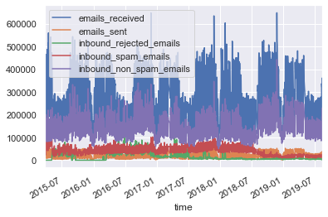
STATISTICAL DATA EVALUATION
BASIC STATISTICS

Slide 28
STATISTICAL DATA EVALUATION
DISTRIBUTIONS
All the attributes are discrete and the distribution that will work with the data is the poisson distribution because it shows how many times an event likely to occur over specific time. Since I am analyzing how users are using a service in G-Suites, more specifically gmail, over time it would make sense to use Poisson Distribution.
The estimators I used is the kernel density estimator to check my distribution modelling I ran a kstests to to find which estimator has the better fit. For majority of the attributes I built an estimator for, it has a good fit.

Slide 29
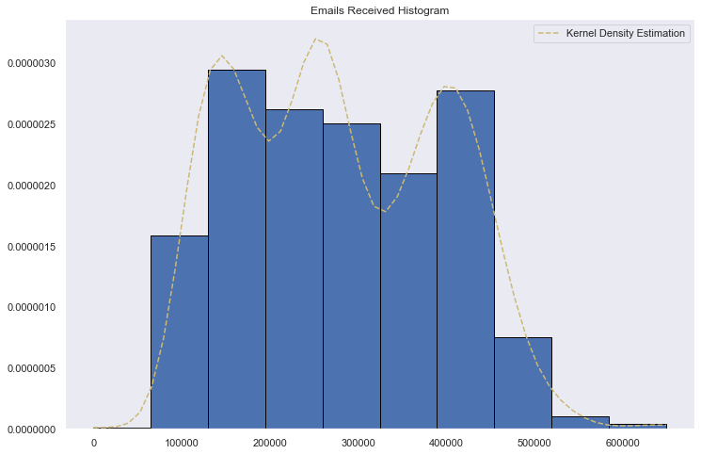
STATISTICAL DATA EVALUATION
DISTRIBUTIONS Continued

Slide 30
STATISTICAL DATA EVALUATION
CORRELATION< COVARIANCE
Emails received and emails sent correlation: .95
Emails receive and inbound non spam emails correlation: .88
Emails sent and inbound non spam emails correlation: .83
These correlations are very strong since it very close to 1, the correlations for the rest of the 5 attributes are less then .50 and thus are weak.

Slide 31
STATISTICAL DATA EVALUATION
Hypothesis Testing
I formed the hypothesis that the number of the 1 day active users in December is smaller when compared to active users for the overall year. I performed a 1 sample t test with 1 day active users in december (sample) and tbe 1 day users mean (population).
The p value is 1.22800432e-10, which is <0.05 which means we to reject the null hypothesis.
Since the mean for december is 14764 and the mean for odu is 17342, and the p value is much less than 0.025 it is concluded that month of december has less active users.
I also did hypothesis testing emails received and emails and I conducted a 2 sample t-test. p value returns 0 when the probability is super small, which means it much less than 0.05 so the null hypothesis is rejected.

Slide 32
Jackie Cuong
Google CALENDAR Analysis

Slide 33

BASIC DATA EXPLORATION
1 outlier
May 4 2018 - 10979 daily active users
Mean without 5/4/2018 - 1560
Max without 5/4/2018 - 3600
Cause?

Slide 34
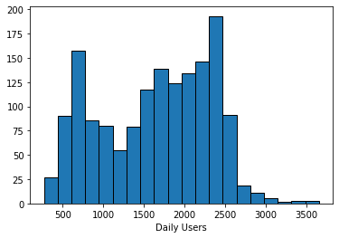
Calendar Distribution
Bimodal distribution
Possible causes-
Fall/Spring and Summer/Winter
Midterms and final exams

Slide 35
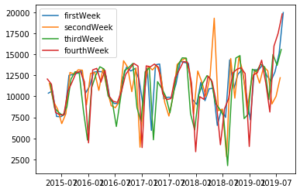
Calendar Hypothesis
Hypothesis: The third week of the month has a significant difference to the rest of the weeks.
T-test: mean of third week compared to mean of rest of the weeks
Result: p-value of 0.01, significantly lower than
.025. reject null hypothesis, conclude
third week of month is significantly
different. Mean for third week is 10750
Mean for rest of weeks 11193.

Slide 36
TASK BY HIEU VO
GOOGLE ACCOUNTS:
BASIC STATISTICS
DISTRIBUTIONS and estimates
Point estimates, confidence intervals.
CORRELATION, COVARIANCE
HYPOTHESIS TESTING.

Slide 37
BASIC DATA EXPLORATION
DATA DESCRIPTION:
working with all the metric that deal with google accounts.
DATA CLEANING:
working with the metric that have more than 1000 occurrence.

Slide 38
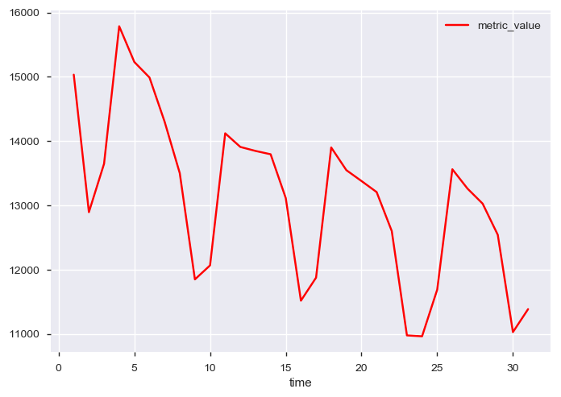
STATISTICAL DATA EVALUATION
FINDING THE CORRALATION BETWEEN 1 DAY ACCTIVE USER AND 30 DAY ACCTIVE USER.
HYPOTHESIS TEESTING BETWEEN 1 DAY LOGIN AND ACTIVE USERS

Slide 39
PROGRESS TOWARDS GOALS
PROGRESS MADE TOWARDS GOALS FOR GOOGLE ACCOUNTS:
WORKING TO COMPLETE MORE STATISTICAL ANALYSIS AND CREATE CORRALATION MATRIX
APPLYING AND TESTING OUT PANDAS_PROFILING

Slide 40
QUESTIONS?

